Slide 1


SDLC
Project Manager
REQUIREMENTS/PLANNING
SPECIFICATION/ANALYSIS
Business Analyst
Technical BA
DESIGN
IMPLEMENTATION/DEVELOPMENT
Developer
DevOps
Tester
TEST
RELEASE
Production Support
USE + Support & REUSE CONFIGURATION
Notes:
Software Development Life Cycle

Slide 2
Key Personnel
Project Manager
Responsible for delivering the project on time, within budget and scope
Business Analyst
Identifies requirements, writes specifications, design applications
Technical Architect
Defines the overall structure of the system along with the hardware it will use
Developers
Developers, team leads and specialists that will design, build and maintain the application
Testers
Testers are responsible for testing any new or modified applications
DevOps/SRE
Responsible for managing and maintaining the applications once they go live
Production Support
DevOps - Bug fixing, testing and releasing, SRE focusses on reliability

Slide 3
Disciplines
UX Design/Frontend
Involves research (Understanding, User Personas, Use Cases, Journey Maps) and brainstorming (creating user flows and wireframes)
Backend Technologies
For writing application/business logic for software like online shopping using languages like Java, Scala, Python, and C#
Operations/Prod Support Technologies
To look after the live application running on production server using SQL, Linux essentials, bash Scripting, and Python.
Cloud Technologies
To create and share the computer resources over the internet using service providers like AWS
Database/Data Science Technologies
UI/Frontend
DevOps
Involves designing visual interfaces for software like an online Shopping application using HTML, CSS and JavaScript, React, Angular and Node.JS
Set of practices for increasing the speed, productivity, equality, and security of orgs - Tools-Git, CI/CD (Jenkins), Docker, Kubernetes and Ansible
Working with databases (MySQL, Postgres, SQL Server and MongoDB (NoSQL), Big Data (Hadoop) using SQL or KDB+/q programming

Slide 4
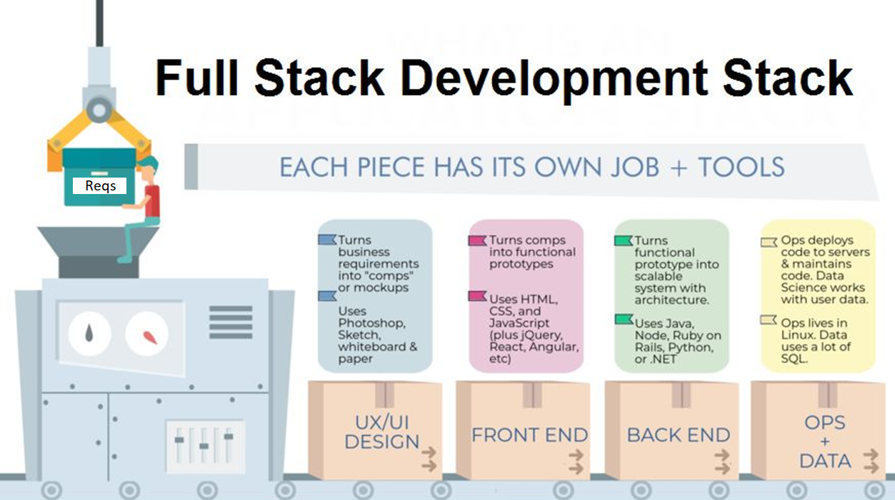
Notes:
For more details: https://redblink.com/become-full-stack-developer-2019-roadmap/

Slide 5
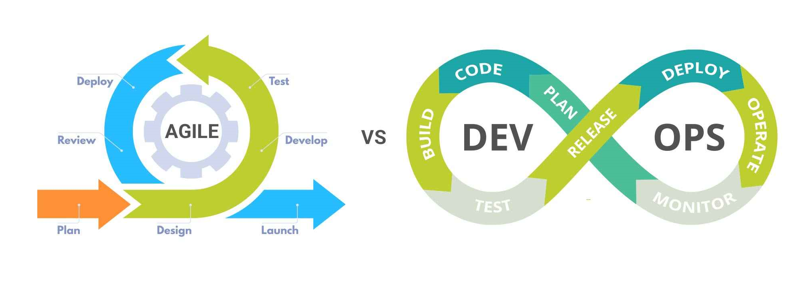
Agile Vs DevOps

Slide 6
Implementation - Example
Pull
Tester
UnPark B, Merge A, Push B
Production Support
Push B
Push B
Push B
Developer
Push B
Push A
Push A
Push A
Win
Clone
Reject
1
2
3
2
Release
Release
Release
Release
Linux
Dev
Linux
QA
Linux
UAT
Linux
Beta
Linux
Prod
Git
Push A
Push A
Win
Push A
Clone
Push B
Push B
Push B
Park B
Pull
Pull
Developer

